Slide 1
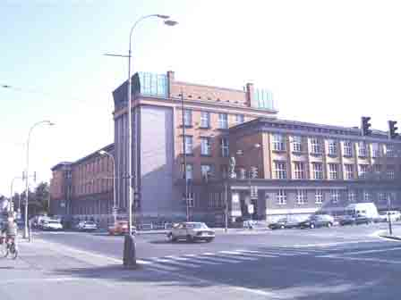
The Secondary School of Electrical Engineering, Pardubice
Something about our school

Slide 2
Our School
The Secondary School of Electrical Engineering, Pardubice
Our School
Our school is located in the Eastern Bohemia in Pardubice, 60km far from Prague

Slide 3
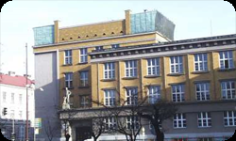
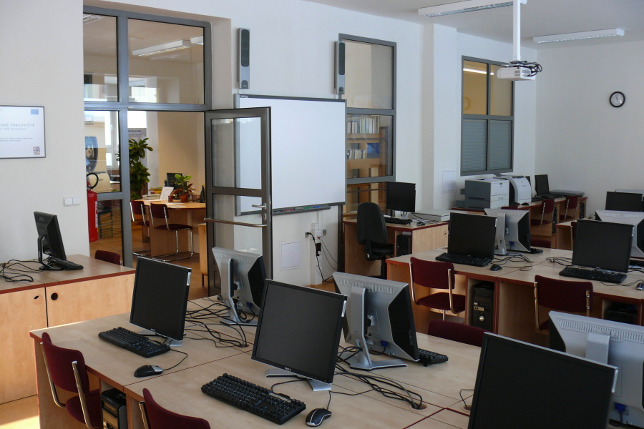
The Secondary School of Electrical Engineering, Pardubice
Our School
The school is 61 years old. Its old looking building is historic and listed. It is located in the center of the city.
The school is 3-storey house with two parts – the old and new one.
In the new section there is a computational center with specialized computer classrooms and an information center also equiped with PCs and used by students in their free time. One hall of the center serves for the public where people can search on the internet..

Slide 4
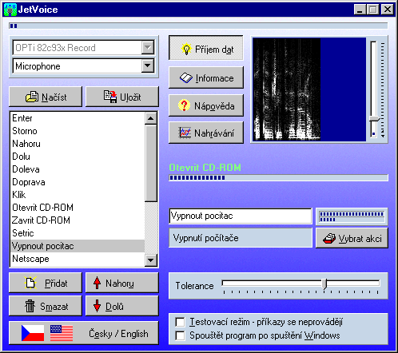
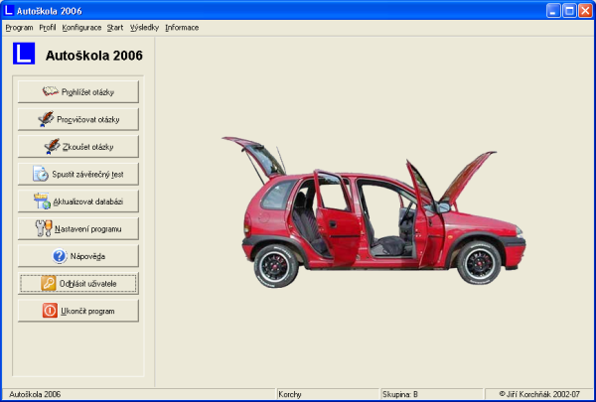
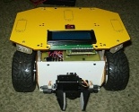
Final projects
The Secondary School of Electrical Engineering, Pardubice
Final projects
The part of Leaving School Exam is a final project
Students have to make a concrete product to prove they can use learnt theory in practice.
These are some programmes, robots, websides, videos etc.
JetVoice programme
Driving school programme

Slide 5
Branches of study
The Secondary School of Electrical Engineering, Pardubice
Our School
In the present time school offers three branches of study:
Information Technologies specialized in programming and hardware
Information Technologies specialized in graphics and webdesign
Electrotechnical Engeneering is divided into subbranches:
Electronic and Communication devices
Computing and Automation technology

Slide 6
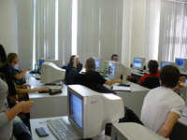
Competitions
The Secondary School of Electrical Engineering, Pardubice
Competitons
PC_ák
Our school organizes this competition every year for pupils from primary schools, mainly for 9th and 8th classes.
At about 160 pupils participate in the competition in which they measure their abilities in working with computers.
This event is being held just this week.
Mathematic competitions
Internet Mathematic Competition – 2011/2012 – the best position of our school was 17th
Regional Mathematic Competition – 2011/2012 – 1st post in three categories
National Math Competition – 2011/2012 – 2nd post was the best we took
And some other less important…

Slide 7
Hobby clubs
The Secondary School of Electrical Engineering, Pardubice
Hobby groups
Every Wednesday when school lessons are over, students can take a part in one of 8 school amateur clubs, which started its work in our school this year
These are for example:
Hand-drawing (for talented artists)
Robot building (students try to build up and program Lego robots)
Programming of games in Java etc.

Slide 8
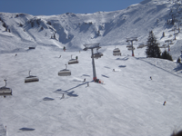
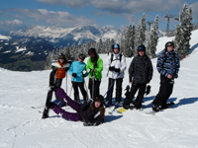
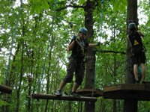
Events
The Secondary School of Electrical Engineering, Pardubice
Events
In the 1st classes students go to an introductory course to built good relations among newcomers
They also go to a ski course in winter
Students of the 3rd classes participate in a sports course where they enjoy playing ball games, climbing, canoeing and other sports among them triathlon is the peak.

Slide 9
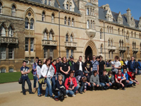
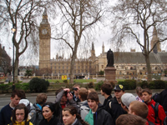
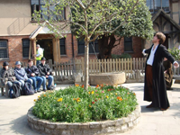
The Secondary School of Electrical Engineering, Pardubice
Events
Every two years some of students have a chance to travel to England, to wellknown places and cities such as Warwick castle, Oxford, Cambridge, Statford upon Avon and London - of course
I took part in this expedition last year, too.

Slide 10
The Secondary School of Electrical Engineering, Pardubice
To get more information about our school and activities, go on our website: www.spse.cz
Now it’s time for your questions ☺

