Slide 1
Pardubice
city of the Czech Republic

Slide 2
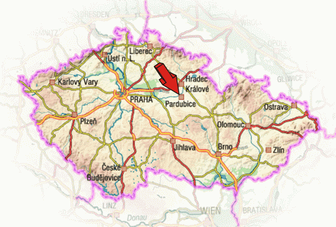
Location
Pardubice is situated in the Eastern Bohemia at the confluence of the rivers Elbe and Chrudimka.

Slide 3
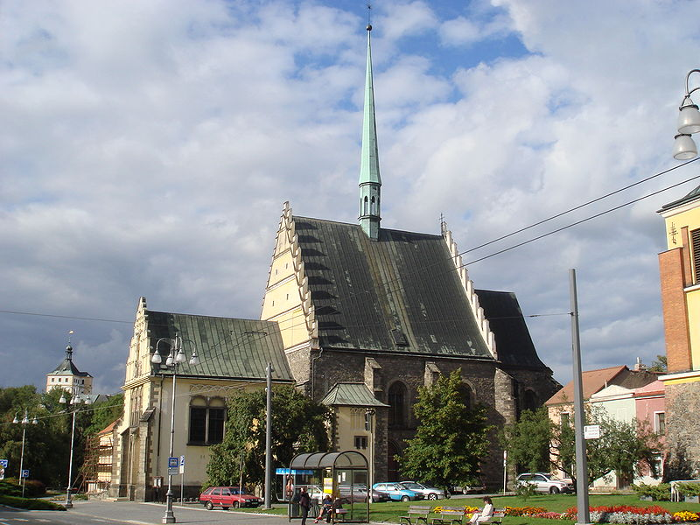
History
The first recorded mention of existence of Pardubice dates back to 1295, when Pope Boniface VIII. in Pardubice confirmed Cyriak monastery and church St. Bartholomew.
Church of St. Bartholomew

Slide 4
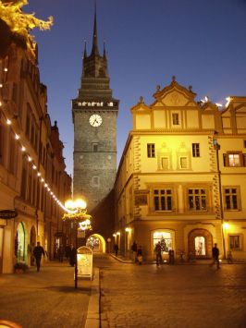
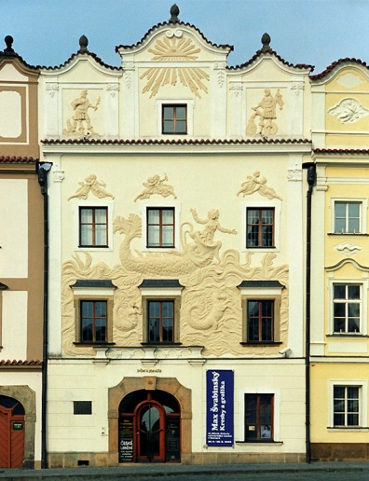
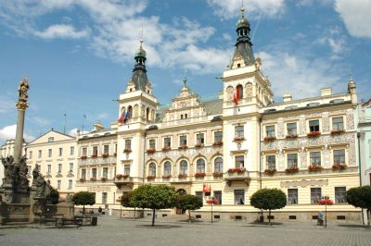
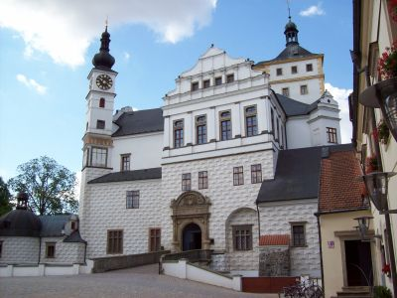
Historic buildings
Pardubice is not a very big city, but it has a beatiful historic buildings
For example Green gate, which is 59 metres tall (gothic and renaissance), House at Jonah with amazing plastic relief, or magnificent townhall and my favourite Pardubice castle (gothic and renaissance)

Slide 5
Industry
The main local sectors of industry are chemical, mechanical and electrical engineering.
main chemical companies in Pardubice are Paramo and Synthesia – Explosia (plastic explosive Semtex was developed in late fifties)
electrotechnic companies: Foxconn (computers), Panasonic (devices for cars)
food industry (Pardubice is known for its famous gingerbread for centuries): Brewery Pardubice

Slide 6
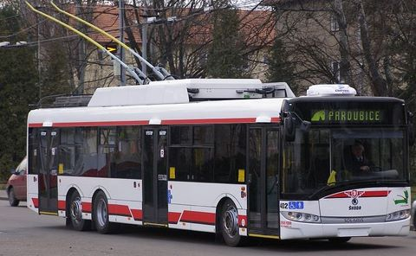
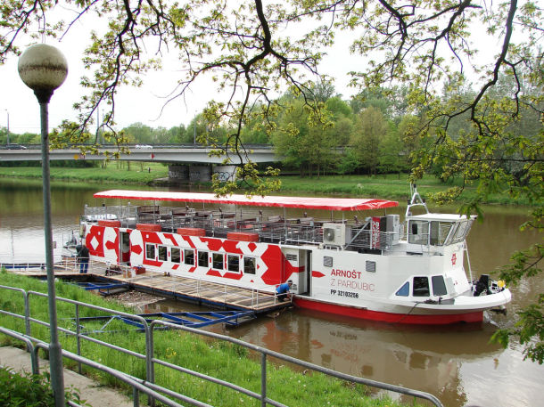
Transportation
In pardubice you can find all kinds of transportation
urban public tranportation, railway , road , waterways and even air transport (13th May 1911 enginner Jan Kašpar made the first long-haul flight from Pardubice to Great Chuchle near Prague. This day is also considered to be symbolic origin of Czech aviation)
so commuting to work, or to school is not a problem ☺

Slide 7
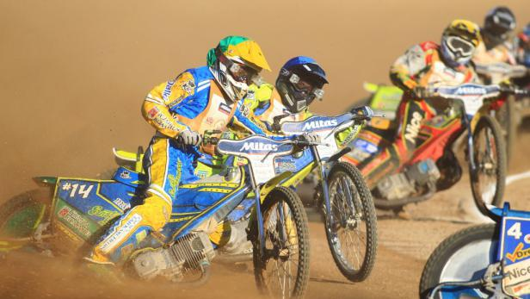
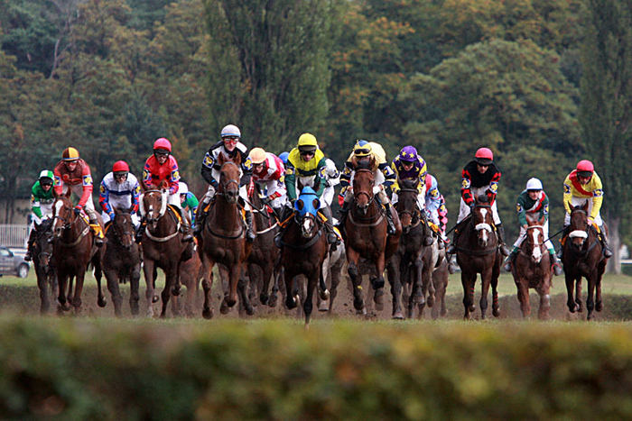
Sport
The famous Great Pardubice Steeplechase has been held on the second Sunday in October since 1874. This is the hardest race in Europe and the second dangerous one in the world.
Golden Helmet of Pardubice is a traditional annual motorcycle race on the speedway. It is the oldest race on the speedway in the world. The race was held in 1929 for the first time.

Slide 8
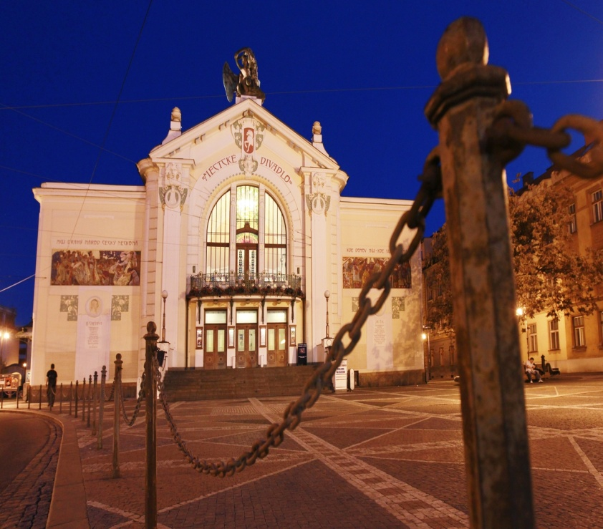
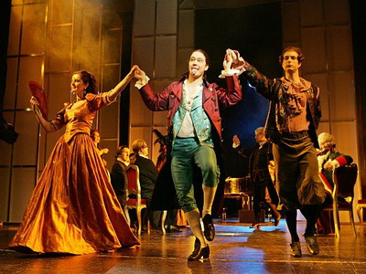
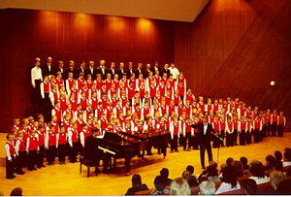
Culture
In the Pardubice there are 4 theaters
The largest and oldest one is East Bohemia theater (1909), followed by Theater Exile, Theater 29 and Joy Puppet Theater DK Dukla.
There are lot singing groups, or bands too

Slide 9
Conclusion
There is more and more information what I can tell you but now i hope you like it
feel free to ask me any questions.
☺

